Slide 1

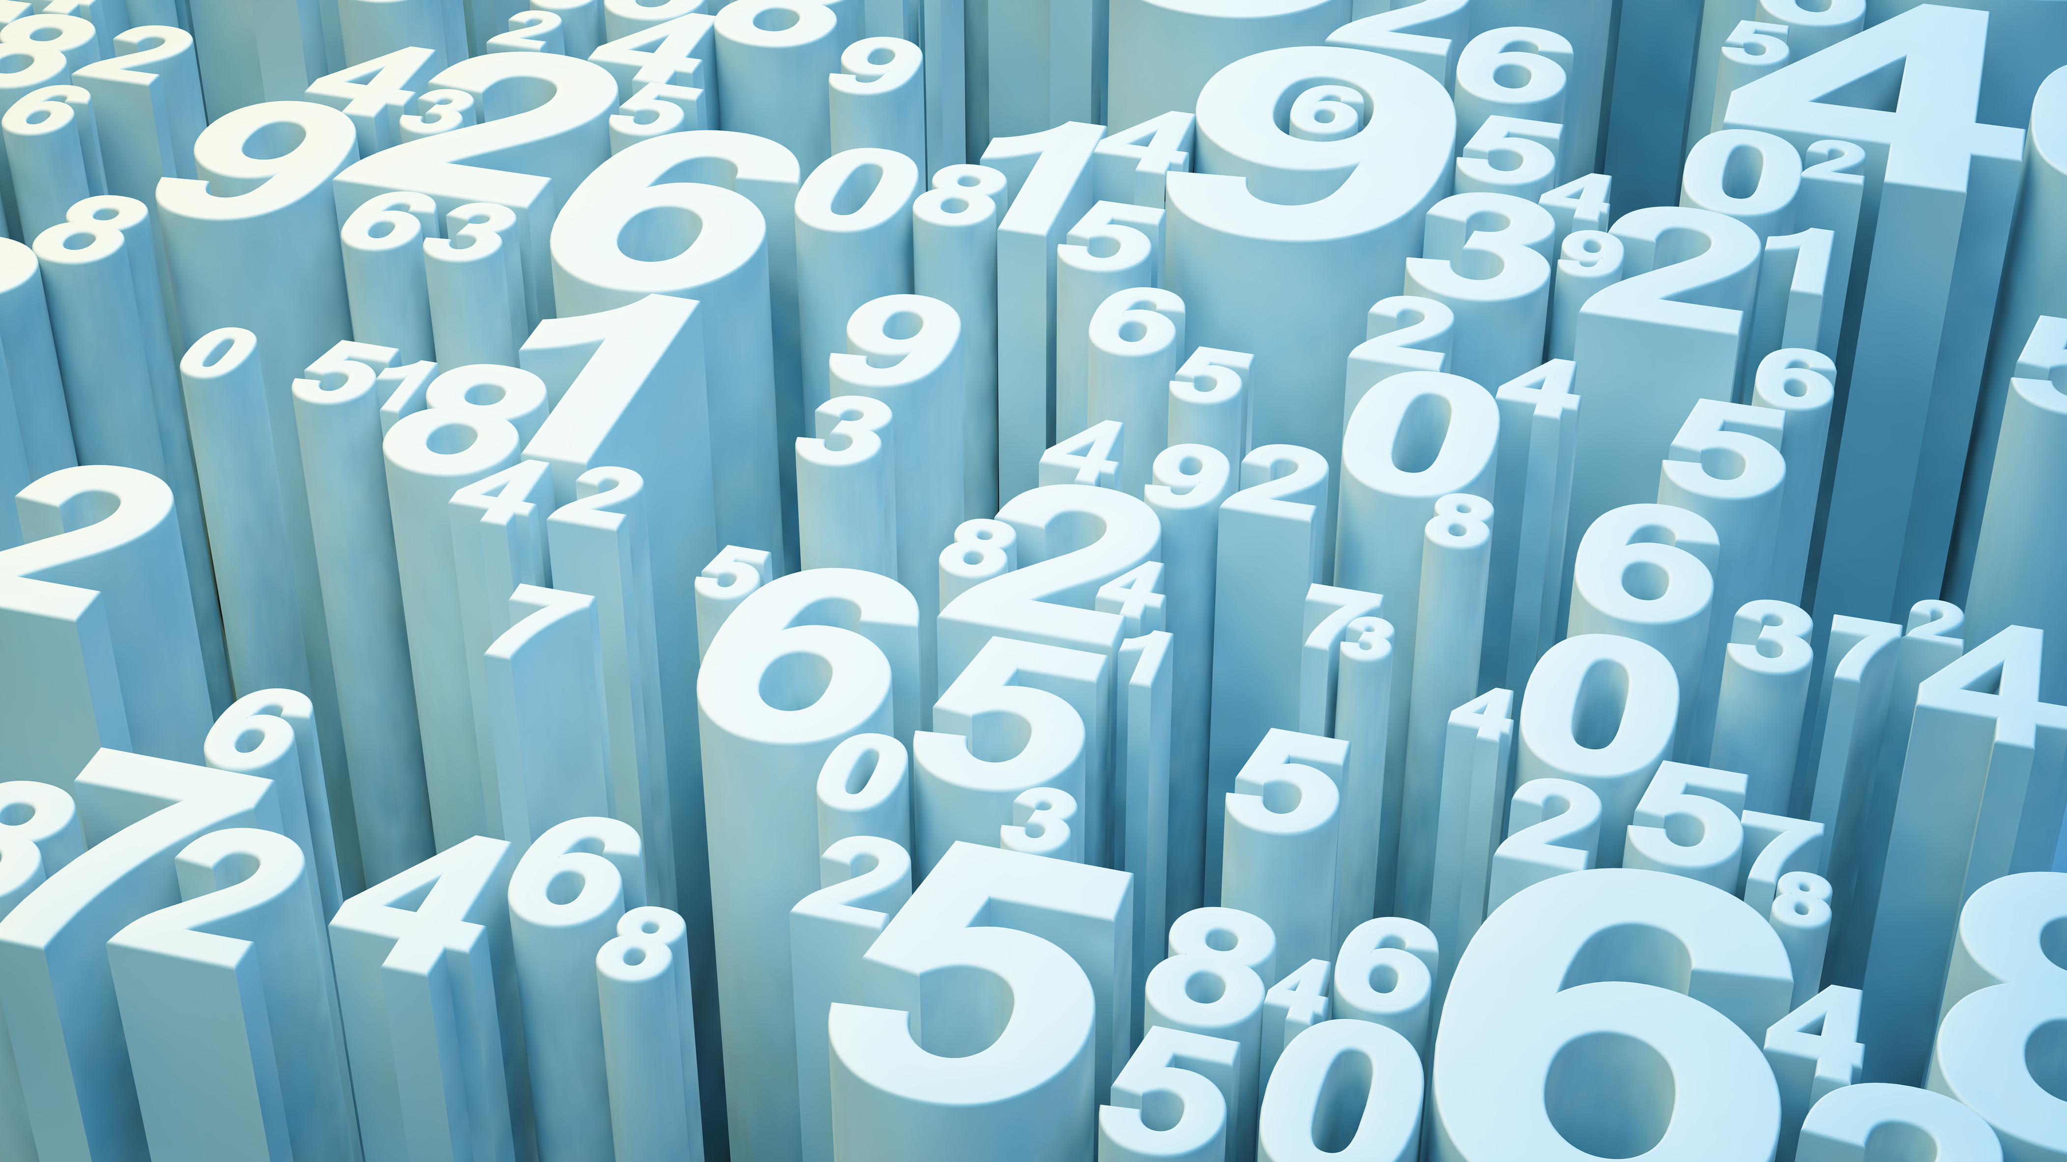
Predicting Pharmacokinetics Properties
Devbrat Anuragi
17078

Slide 2
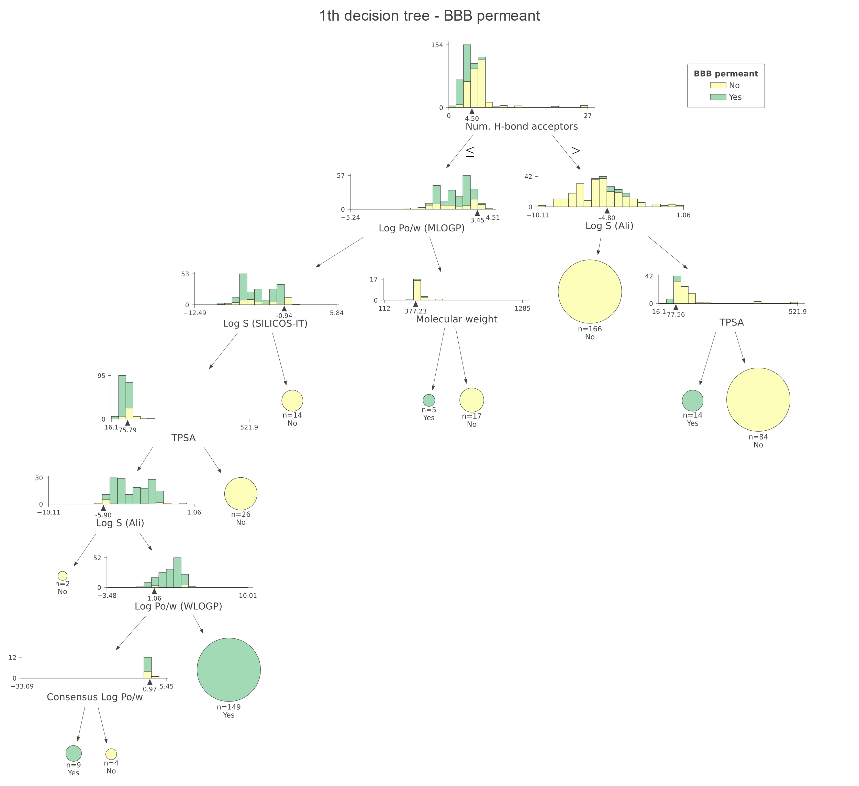
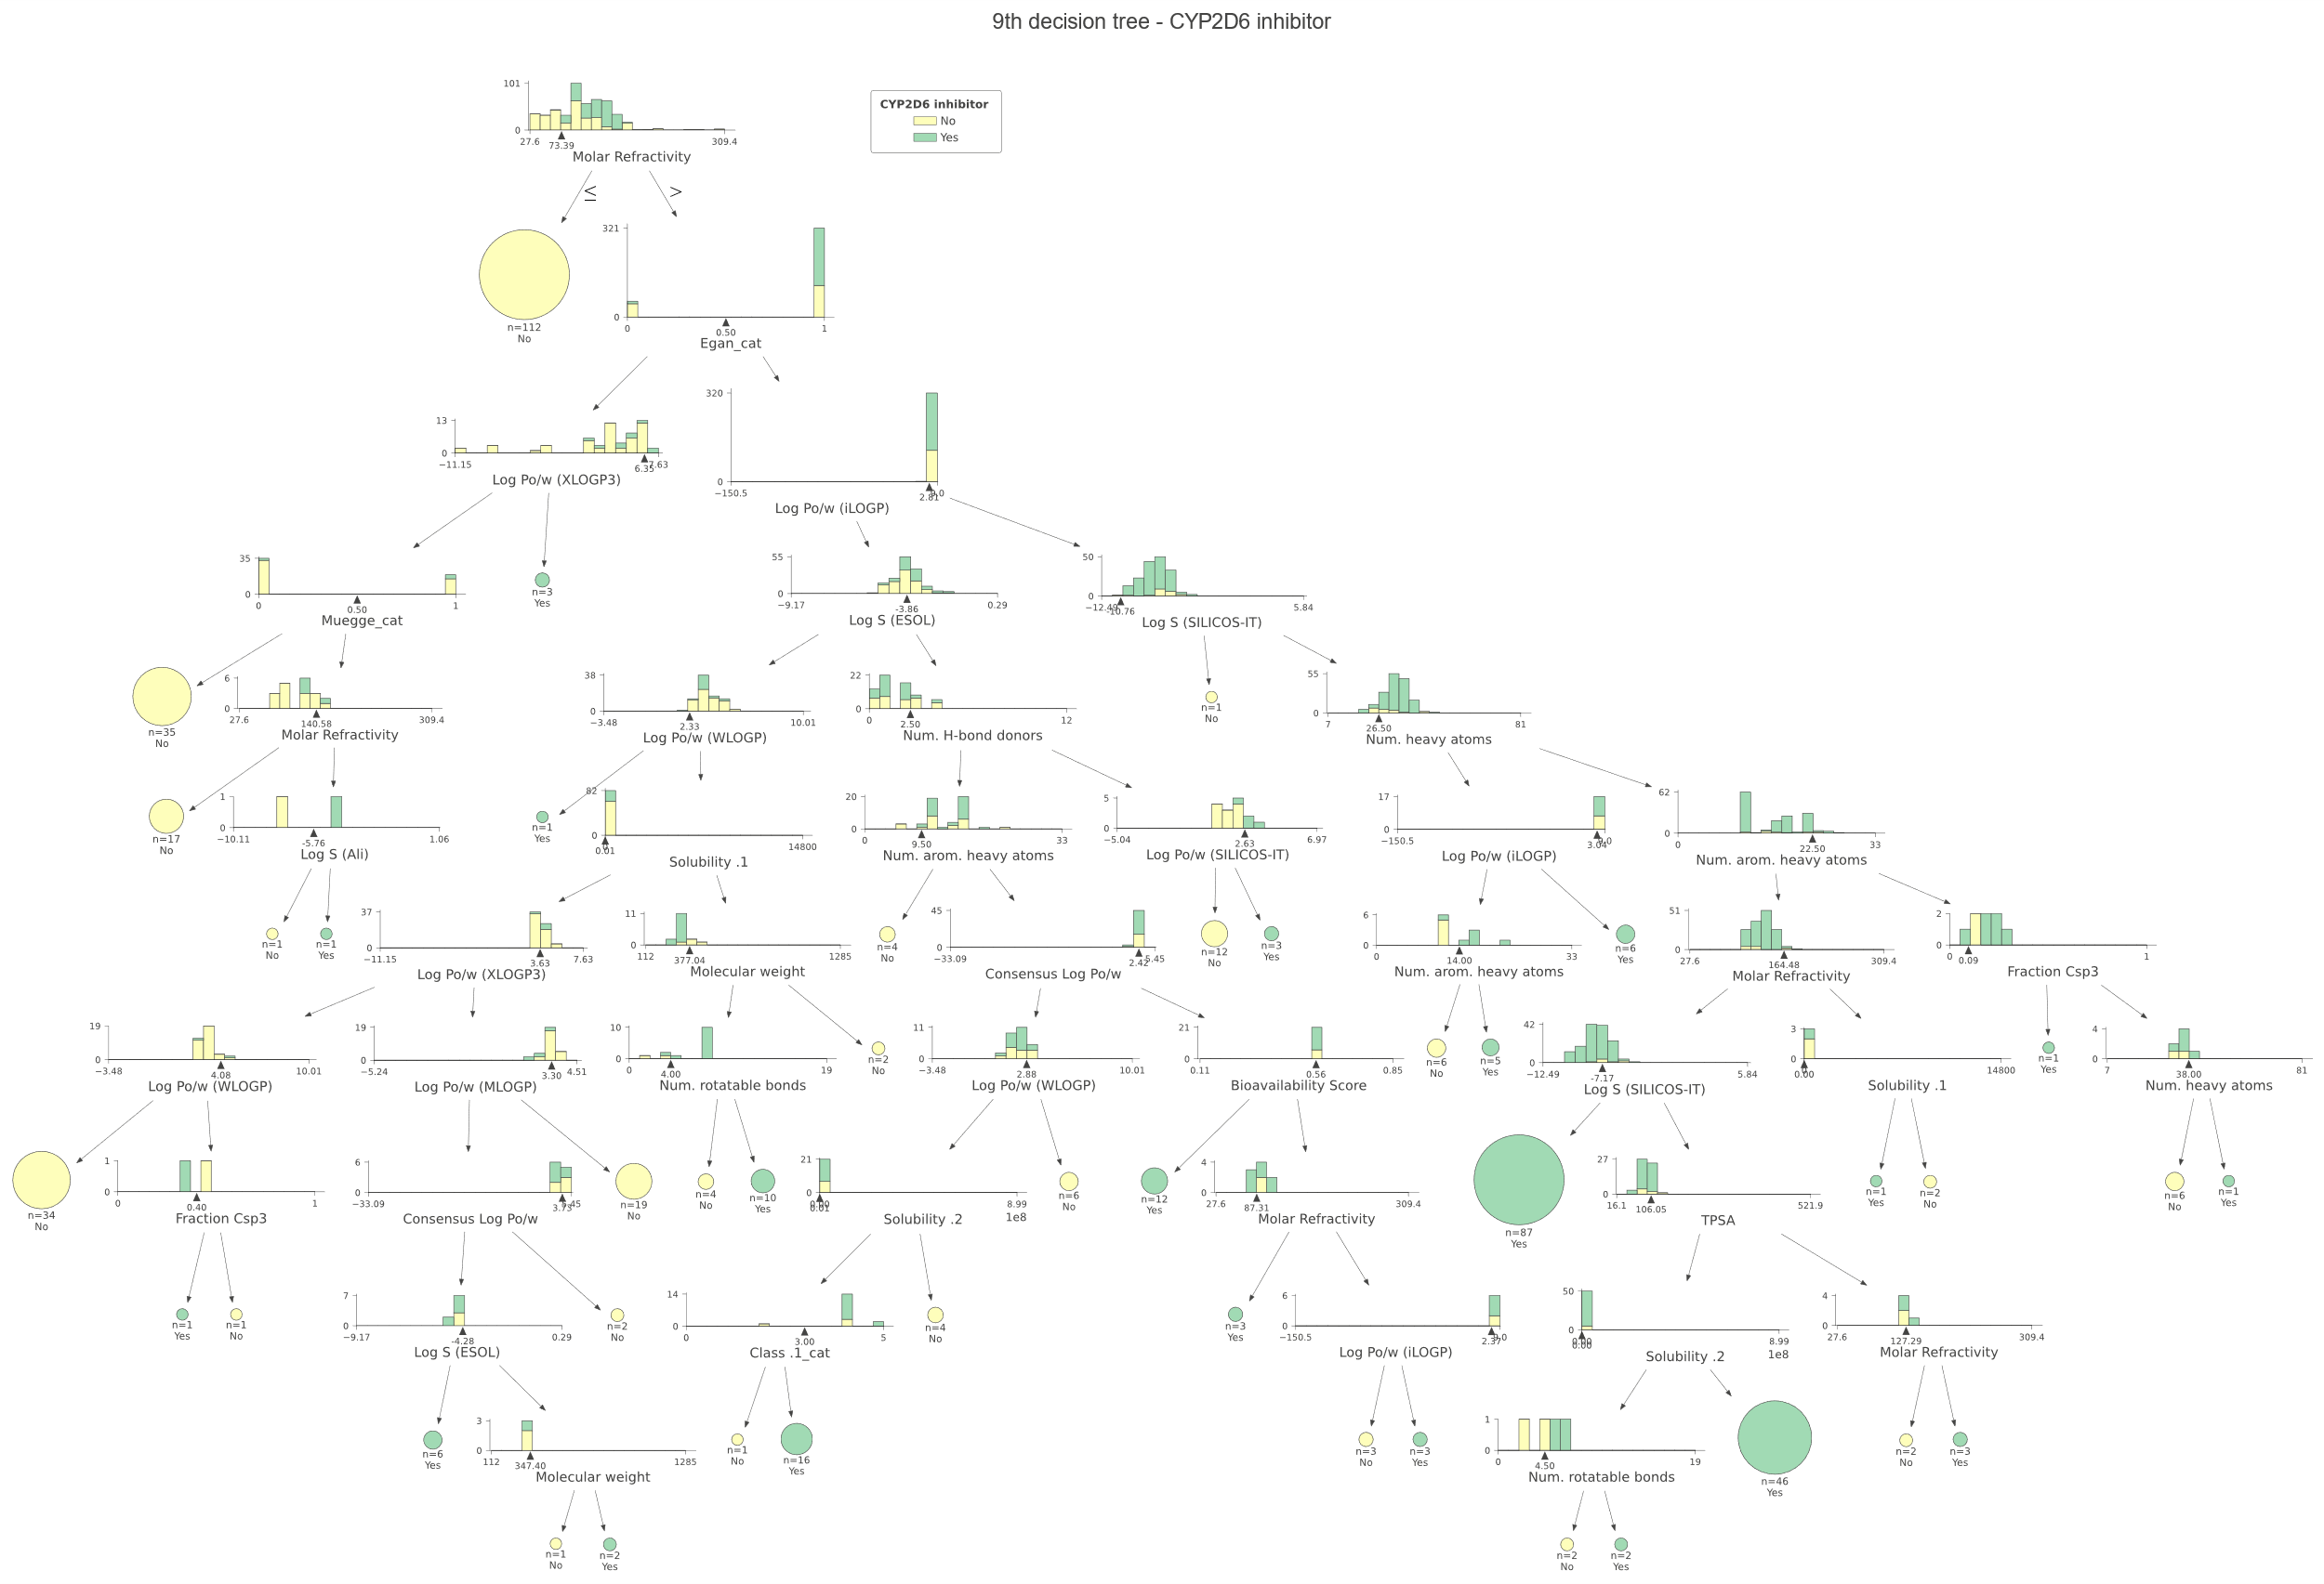
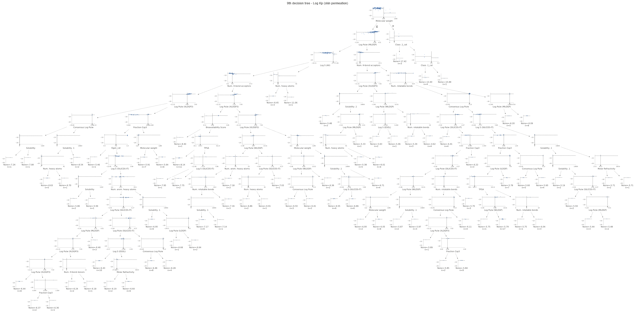
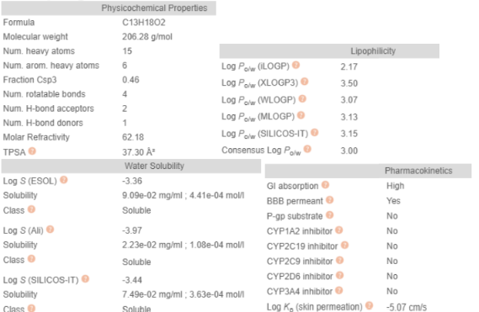
Web Scrape then Parse Then create Random Forest classifier and regressor with an accuracy of atleast 87 %

